Slide 1
Power BI AI

Slide 2



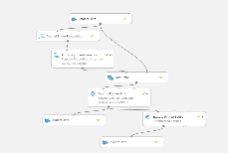
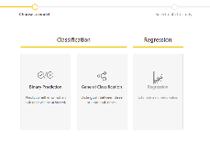
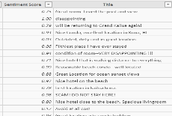
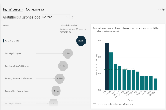
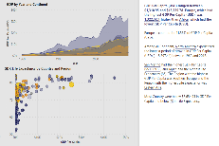
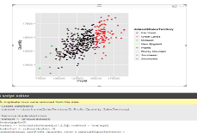
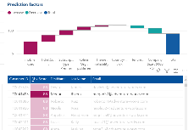
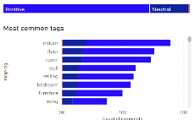
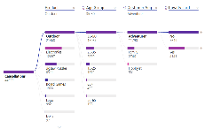
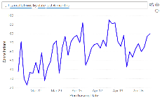

AI in Power BI
Data Scientists
Analysts
Business Users
Create ML models
Sentiment Analysis
Extend with Azure ML
Sentiment Analysis
Key Driver Analysis
Smart Narratives
Python & R Integration
Explore predictions
Key Phrase Extraction
Root Cause Analysis
Q&A

Slide 3
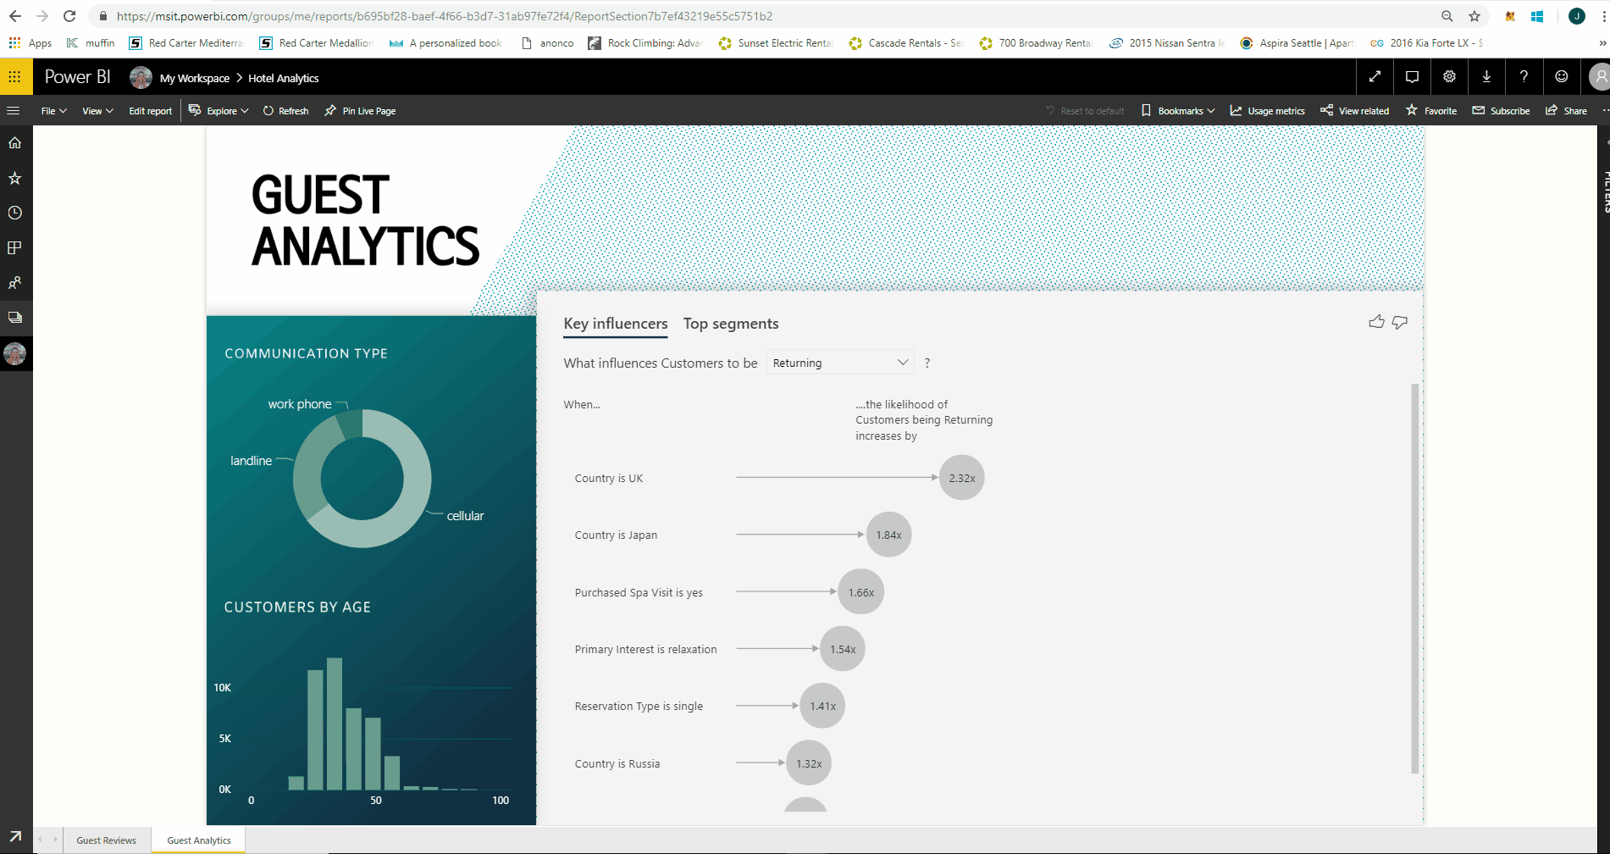
Key Influencers
As an end user find out what drives your KPIs – Key Influencers uncovers what matters.
.

Slide 4
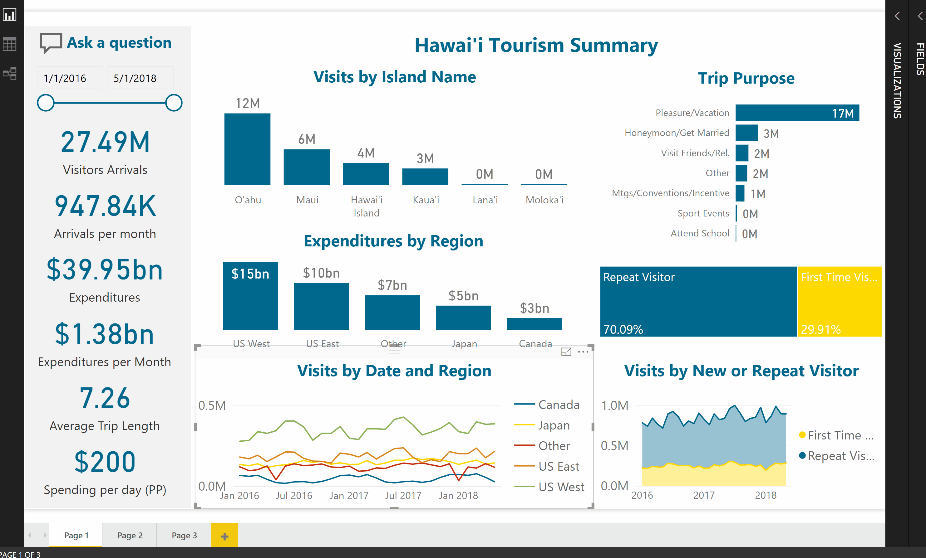
Quick Insights Explain the Increase or Decrease.
Here, we see that the decrease of visitors in summer 2017 was explained by Pleasure/Vacationers. The type of traveler more likely to cancel a trip when Volcanoes erupt!.

Slide 5
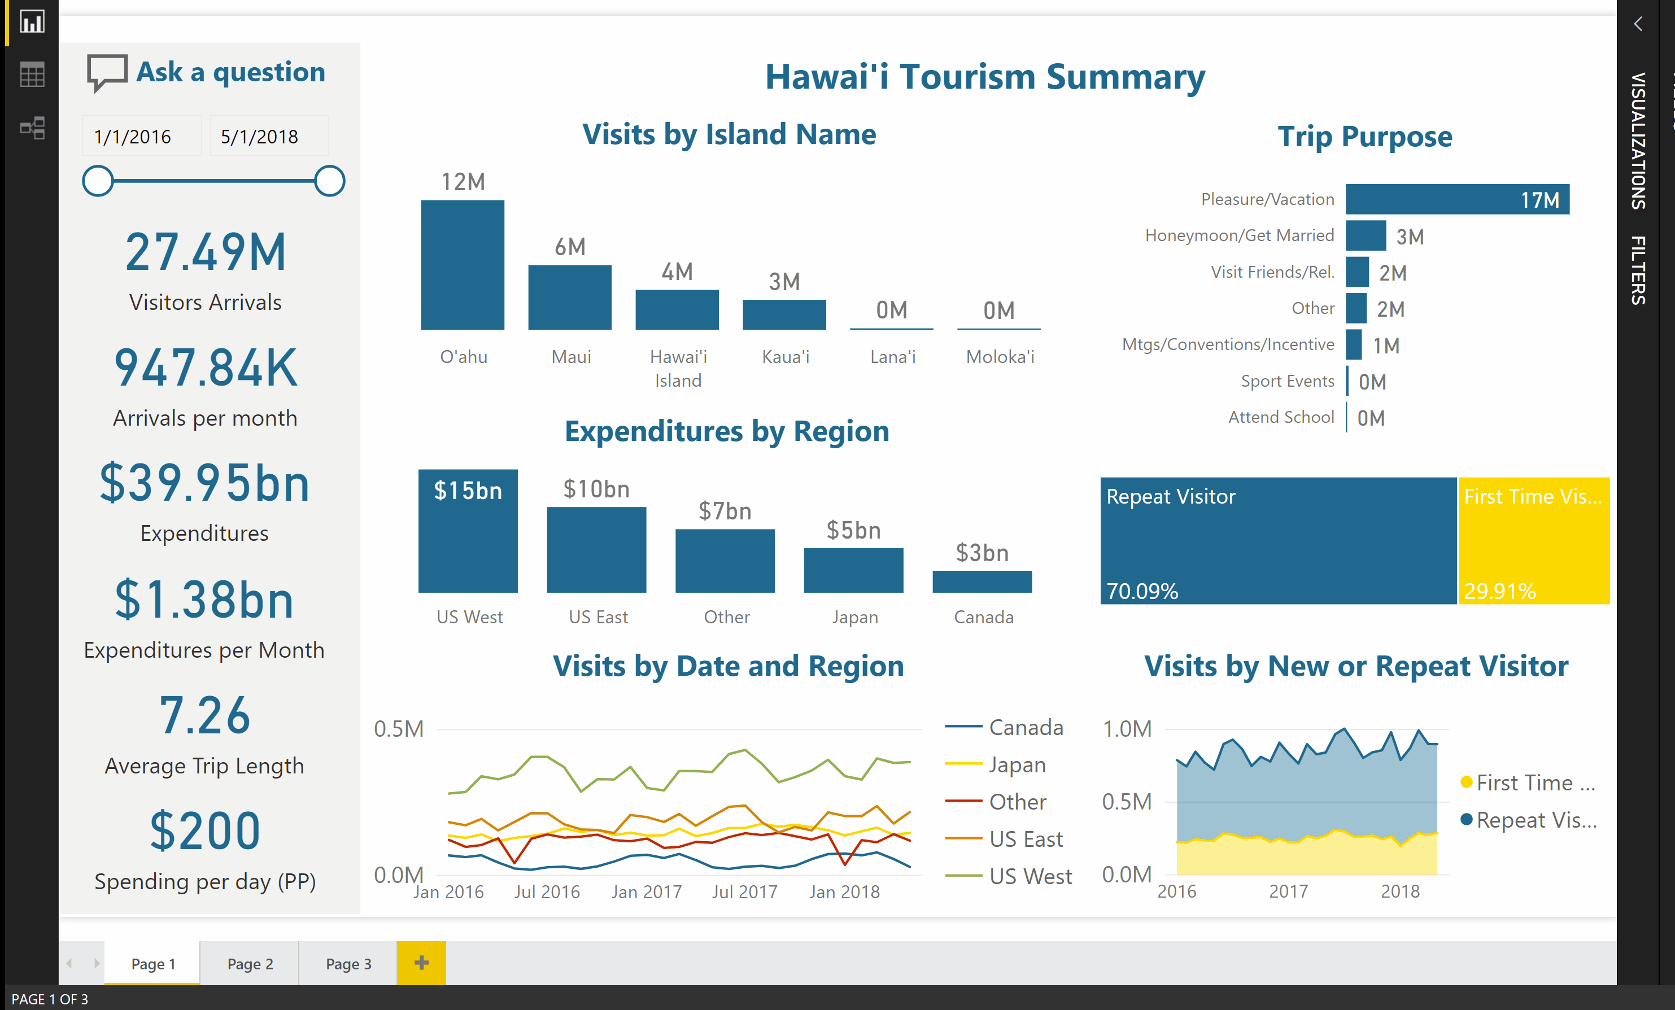
Quick Insights Find where the Distribution is different
In this example, first time visitors visits to islands is different than those who visit several times

Slide 6



















AI for Analysts

Slide 7
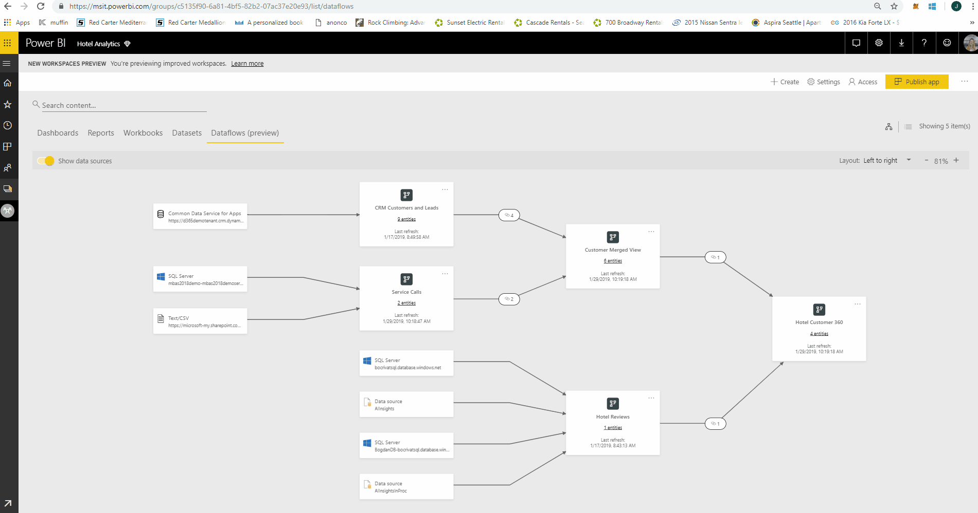
Cognitive Services
Add Sentiment Analysis and Key Phrase extraction to your data.
.
.

Slide 8
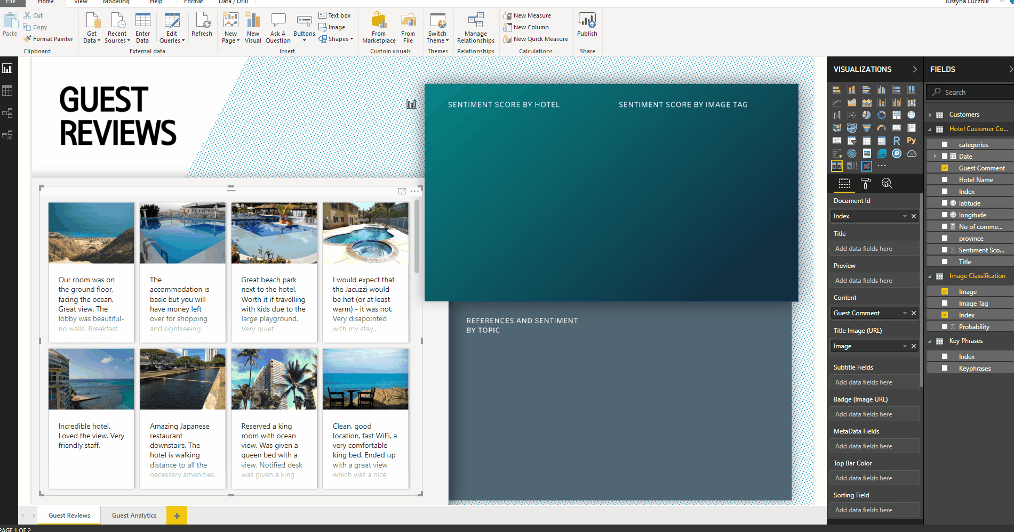
Cognitive Services
Use the results of sentiment analysis and key phrase extraction on unstructured data to create powerful analytics.
.
.
.

Slide 9
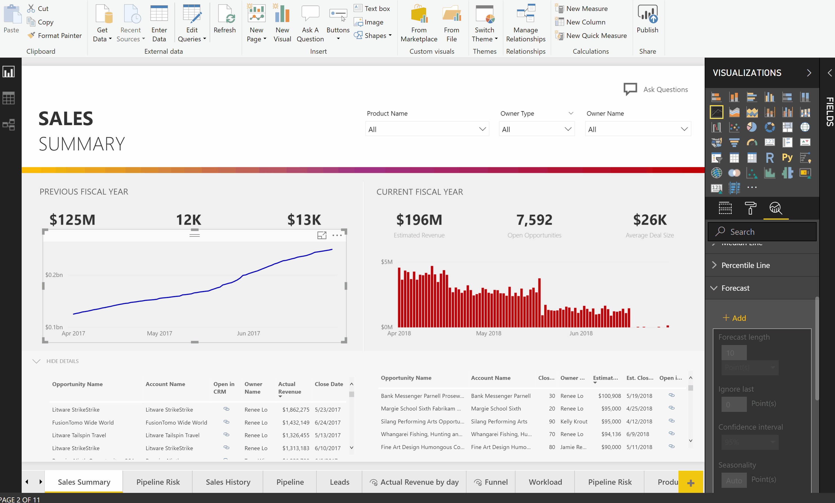
Forecast
Add a forecast line and see future max and min values
.
.
.

Slide 10
















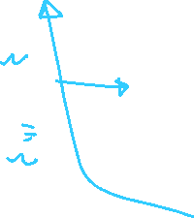

AI for Data Scientists

Slide 11
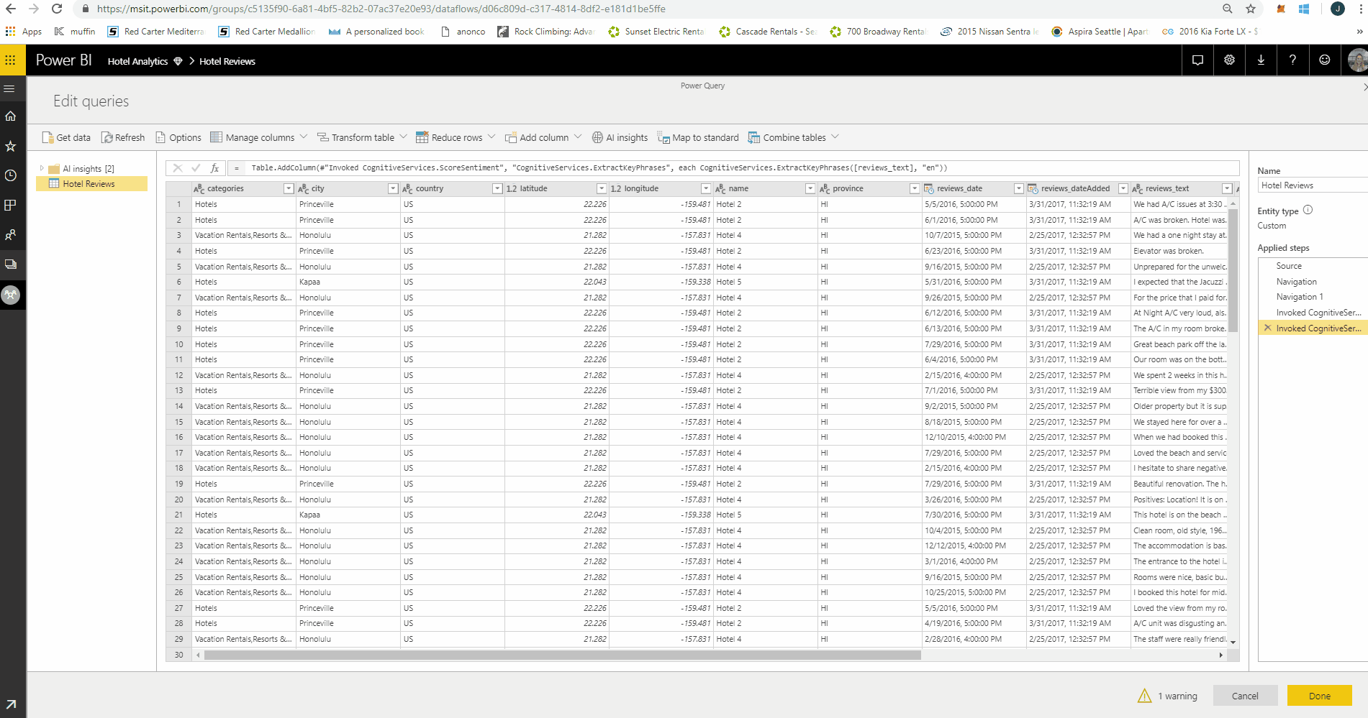
Azure ML Integration
Any Azure Machine Learning model is automatically available to Power BI users simply by giving them the permission to use it.

Slide 12
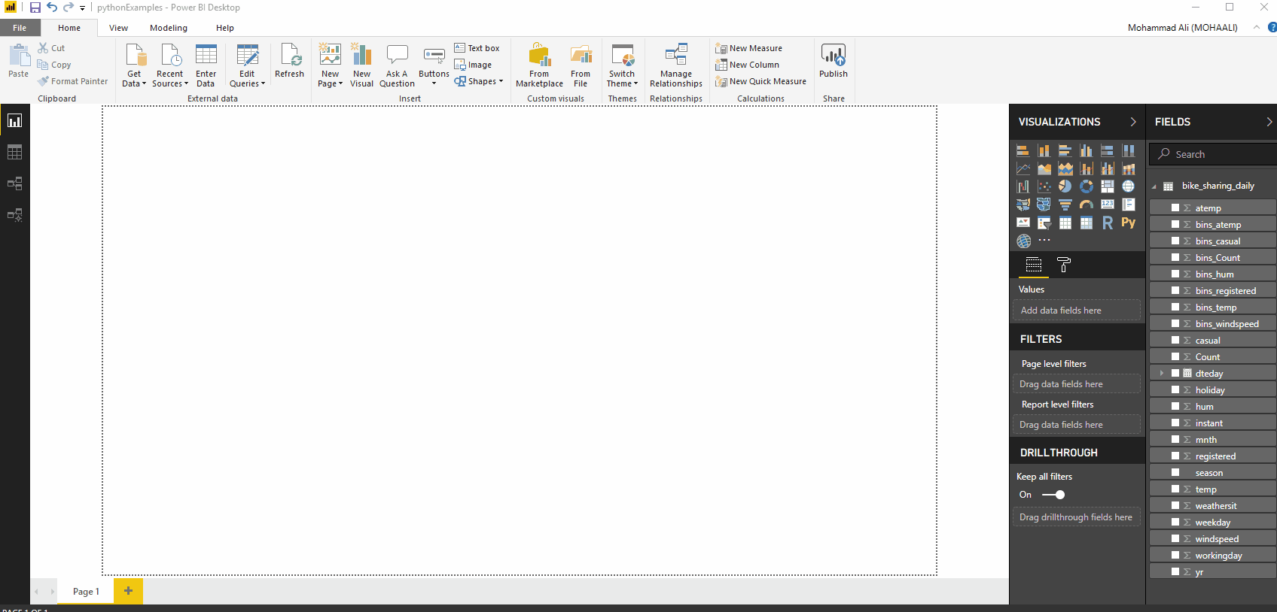
Python Visualization
Use your python scripts in Power BI. Python visualization behaves like any other visualization such than slicing on data triggers the script to rerun and the visual is refreshed.
.

Slide 13
Q&A ?

